Slide 1
Windows Sysinternals 技術報告

Slide 2
agneda
Windows Sysinternals
Process Explorer
Autoruns
Process Monitor
Proc Dump
學習心得

Slide 3
Process Explorer

Slide 4
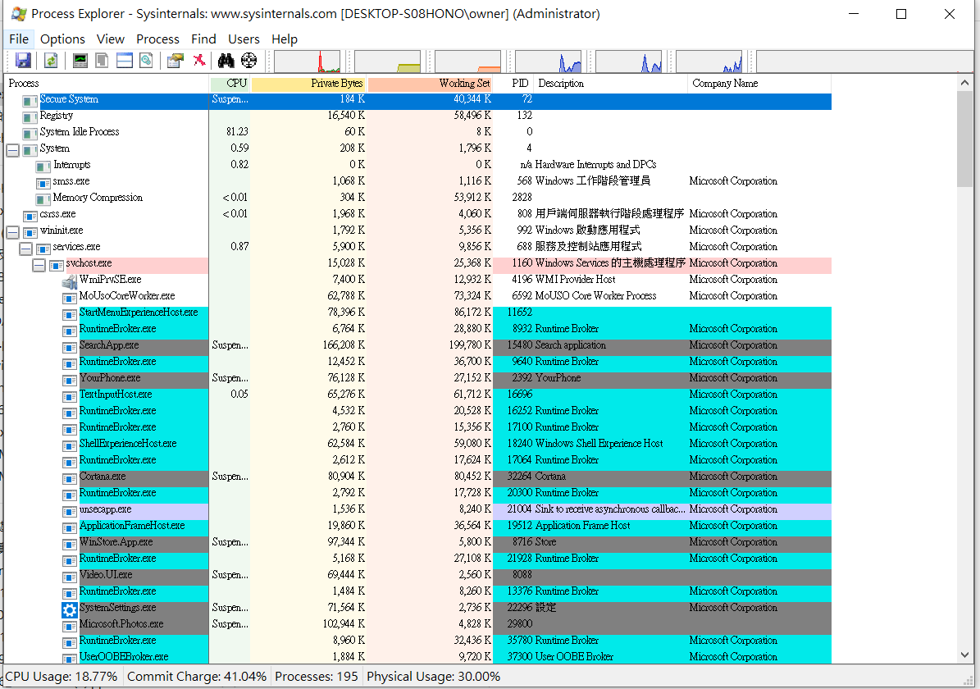

Slide 5
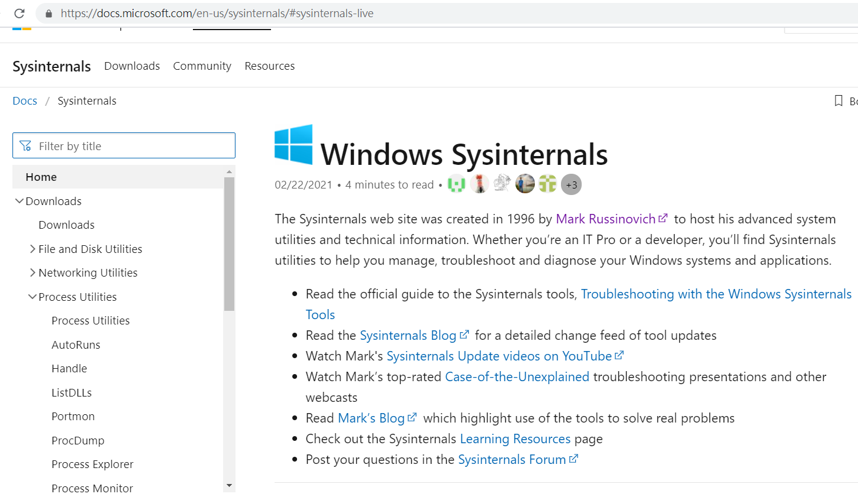

Slide 6
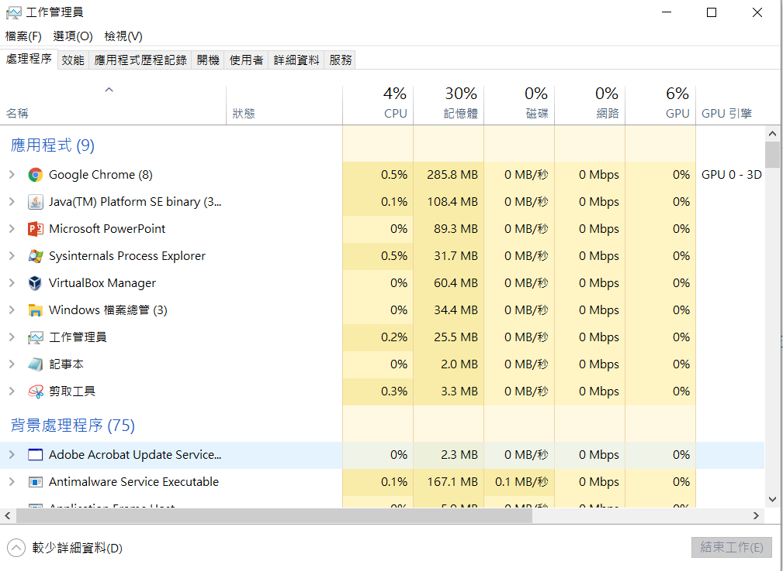

Slide 7
Coreinfo

Slide 8
Coreinfo is a command-line utility that shows you the mapping between logical processors and the physical processor, NUMA node, and socket on which they reside, as well as the cache’s assigned to each logical processor.
It uses the Windows’ GetLogicalProcessorInformation function to obtain this information and prints it to the screen, representing a mapping to a logical processor with an asterisk e.g. ‘*’.
Coreinfo is useful for gaining insight into the processor and cache topology of your system.

Slide 9
Coreinfo是一個命令行實用程序，向您顯示邏輯處理器與物理處理器，NUMA節點和它們所駐留的套接字之間的映射，以及分配給每個邏輯處理器的緩存。
它使用Windows的GetLogicalProcessorInformation函數來獲取此信息並將其打印到屏幕上，以星號（例如“ *”）表示到邏輯處理器的映射。
Coreinfo對於深入了解系統的處理器和緩存拓撲很有用。

Slide 10
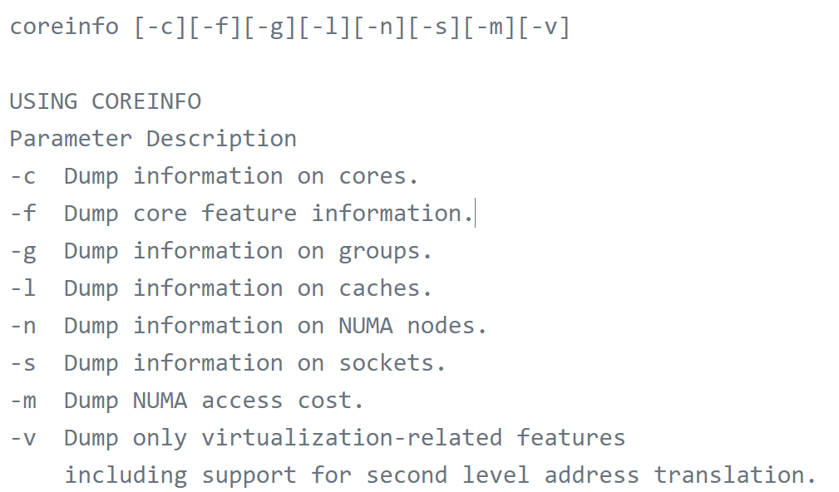

Slide 11
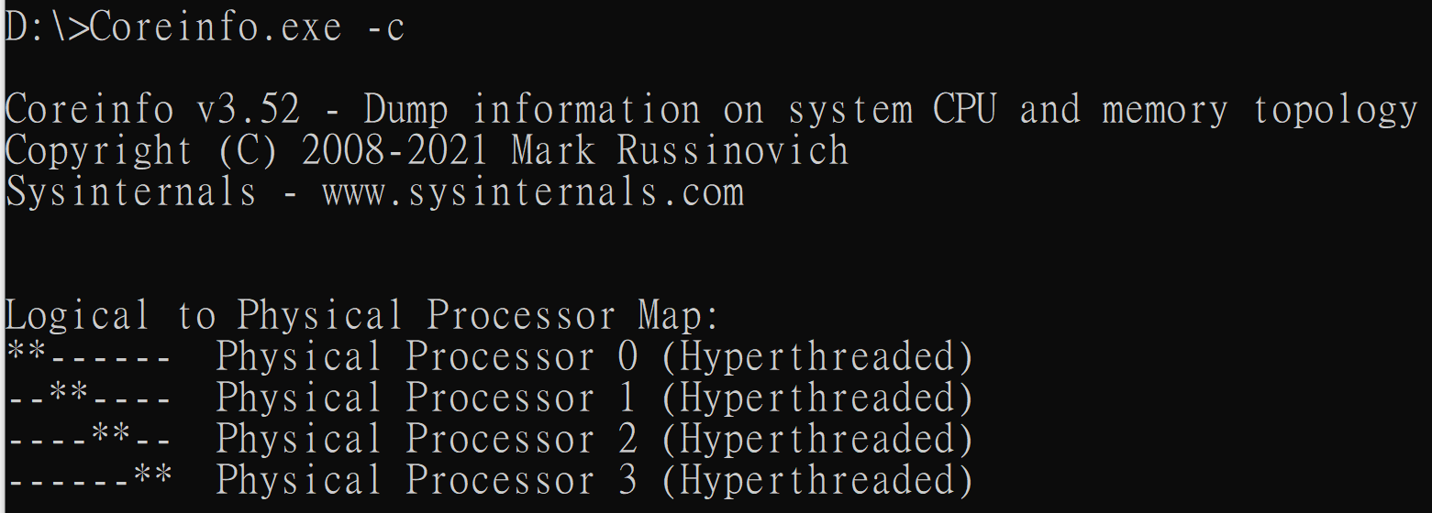

Slide 12
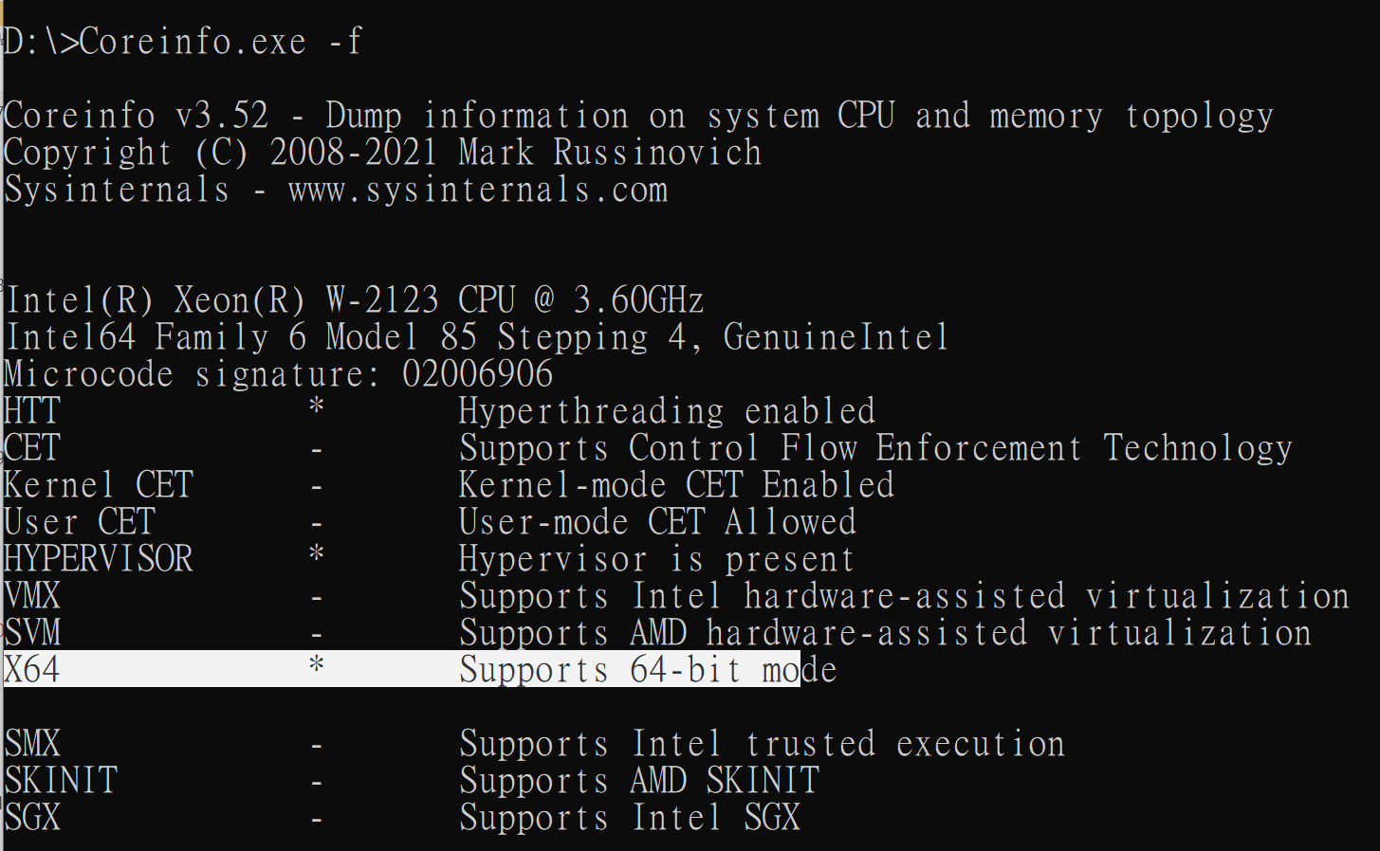

Slide 14
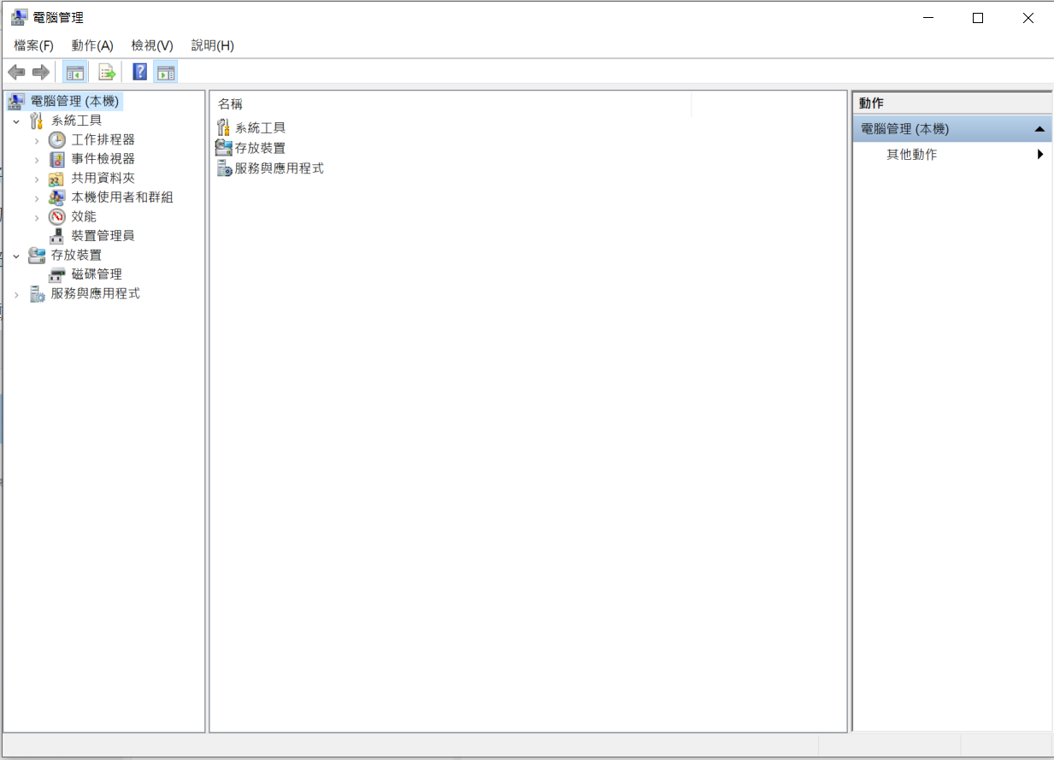

Slide 15
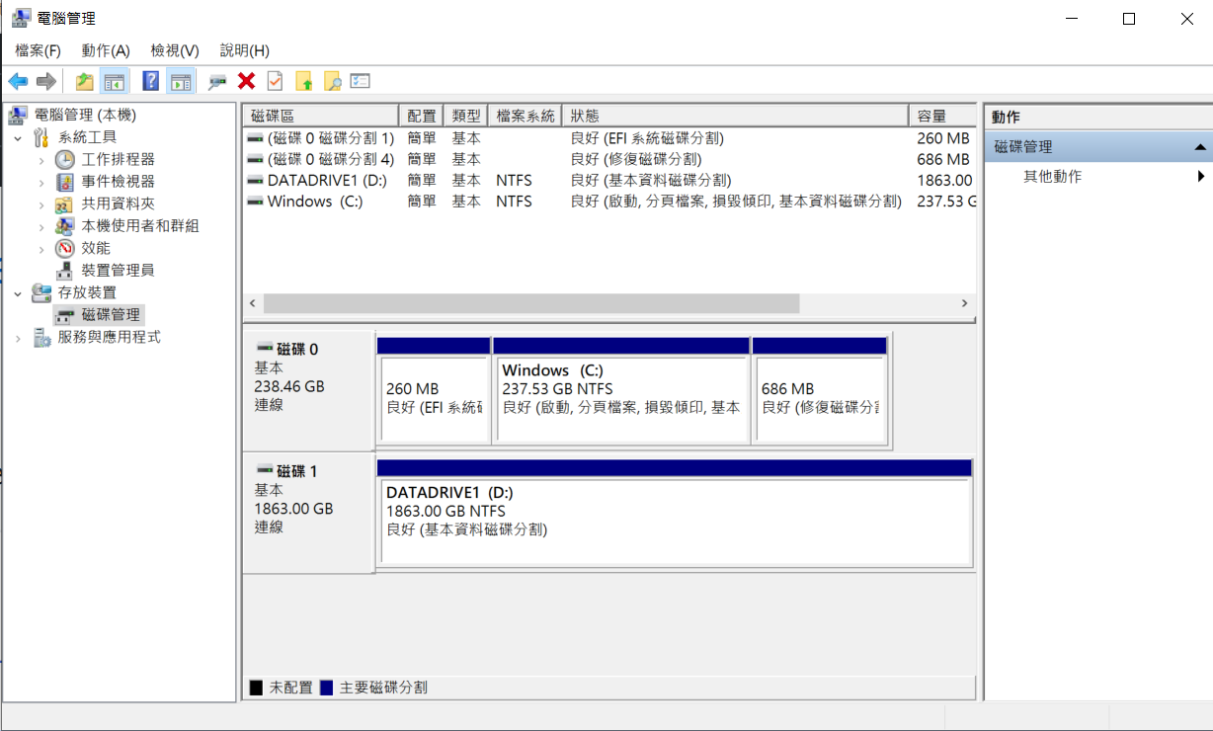

Slide 17
